Slide 1
HTML – Continued..
Instructor: Manu Peethambar
E-mail: cm13055@umbc.edu
Telegram handle: @manupeethambar888
Slides: https://github.com/manupeethambar888/webdev

Slide 2
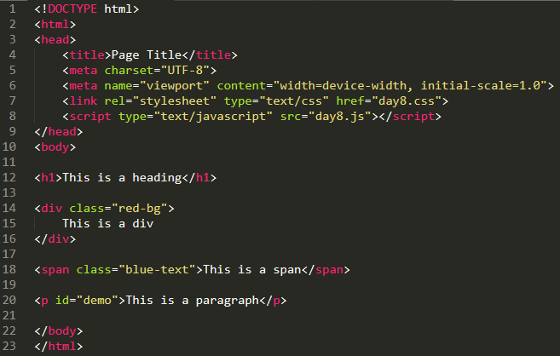
Creating HTML with external css and js files

Slide 3
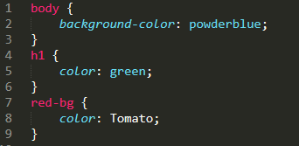
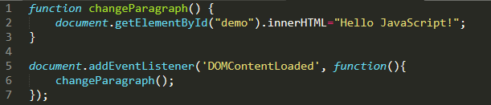
External css and js files
Create a new file and save it as day8.css
Create a new file and save it as day8.js

Slide 4
HTML Multimedia
Multimedia comes in many different formats. It can be almost anything you can hear or see.
Examples: Images, music, sound, videos, records, films, animations, and more.
Web pages often contain multimedia elements of different types and formats.
Multimedia elements (like audio or video) are stored in media files.
The most common way to discover the type of a file, is to look at the file extension.
Multimedia files have formats and different extensions like: .swf, .wav, .mp3, .mp4, .mpg, .wmv, and .avi.

Slide 5
HTML5 Video
To show a video in HTML, use the <video> element.
The controls attribute adds video controls, like play, pause, and volume.
It is a good idea to always include width and height attributes. If height and width are not set, the page might flicker while the video loads.
The <source> element allows you to specify alternative video files which the browser may choose from. The browser will use the first recognized format.
The text between the <video> and </video> tags will only be displayed in browsers that do not support the <video> element.
To start a video automatically use the autoplay attribute.
Practice: https://www.w3schools.com/html/tryit.asp?filename=tryhtml5_video

Slide 6
HTML5 Audio
The HTML5 <audio> element specifies a standard way to embed audio in a web page.
The controls attribute adds audio controls, like play, pause, and volume.
The <source> element allows you to specify alternative audio files which the browser may choose from. The browser will use the first recognized format.
The text between the <audio> and </audio> tags will only be displayed in browsers that do not support the <audio> element.
Practice: https://www.w3schools.com/html/tryit.asp?filename=tryhtml5_audio_all

Slide 7

HTML YouTube Videos
The easiest way to play videos in HTML, is to use YouTube.
YouTube Video Id
YouTube will display an id (like tgbNymZ7vqY), when you save (or play) a video.
You can use this id, and refer to your video in the HTML code.
Playing a YouTube Video in HTML
To play your video on a web page, do the following:
Upload the video to YouTube
Take a note of the video id
Define an <iframe> element in your web page
Let the src attribute point to the video URL
Use the width and height attributes to specify the dimension of the player
Add any other parameters to the URL

Slide 8

YouTube – Autoplay
You can have your video start playing automatically when a user visits that page by adding a simple parameter to your YouTube URL.
Value 0 (default): The video will not play automatically when the player loads.
Value 1: The video will play automatically when the player loads.

Slide 9

YouTube – Loop
Value 0 (default): The video will play only once.
Value 1: The video will loop (forever).

Slide 10

YouTube – Controls
Value 0: Player controls does not display.
Value 1 (default): Player controls display.

Slide 11
Assignment 8 due – 7/6/2018
Create a sample html file:
Create an iframe to embed a YouTube video of your choice.
Make the video autoplay when the player loads.
Save this as “assignment8.html” in your repository in Homework folder in “Assignments_yourname”.
Commit and push the changes to the repository.

